Slide 1
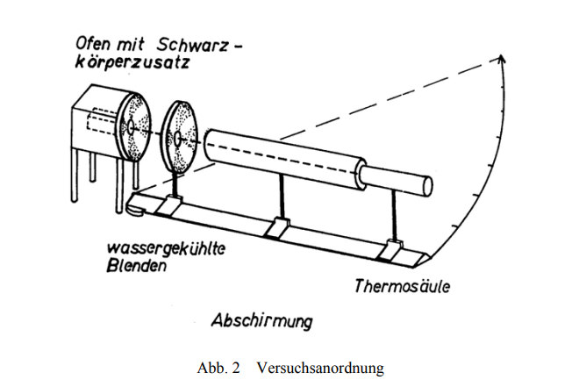
Cavity radiator
Water cooled aperture
Thermopile
Shielding

Slide 2
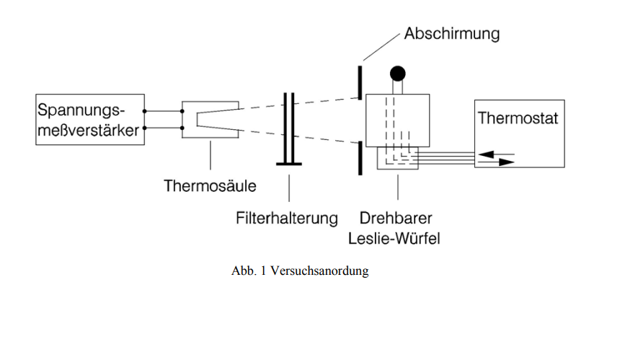
Shielding
Voltage amplifier
Thermopile
Filter
Leslie cube

